Slide 1
Introduction to Databases

Slide 2
What is a Database (DB)?
A database is any collection of related information that can be stored in different ways.
Examples:
Information stored in :
Phone book
Shopping list
Todo list
Your 5 best friends

Slide 3
Database Management System (DBMS)
A special software program that help users create and maintain a database.
Makes it easy to manage large amounts of information
Handles security
Backups
Importing/Exporting data
Concurrency
Interacts with software applications

Slide 4


Slide 5
Types of Databases
Relational Databases (SQL)
Organize data one or more tables
Each table has rows and columns
A unique key identifies each row
Non- Relational (noSQL)
Organize data in anything but a traditional table
Key-value stores
Documents (JSON, XML, etc)
Graphs
Flexible tables

Slide 6
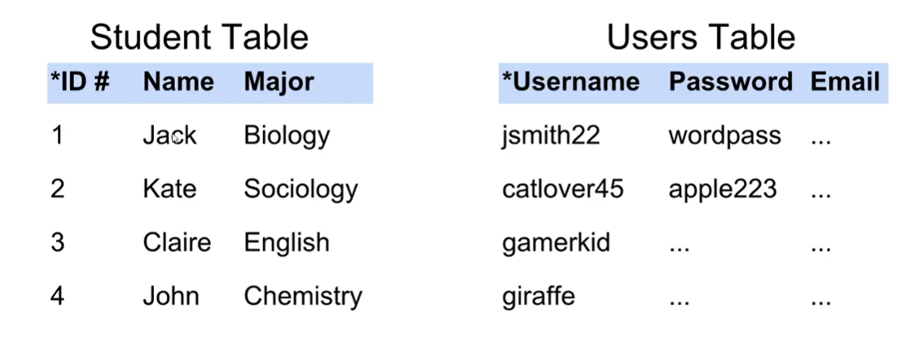
Relational Database

Slide 7
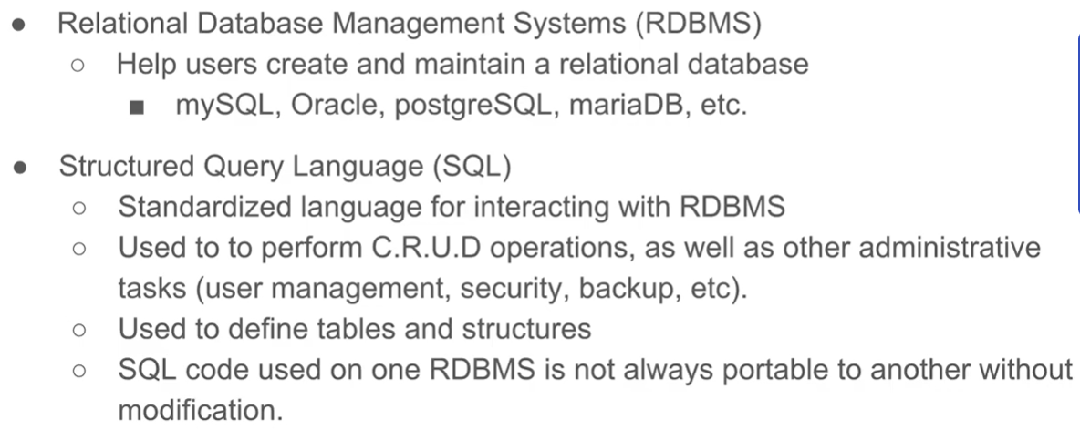
Relational Data

Slide 8
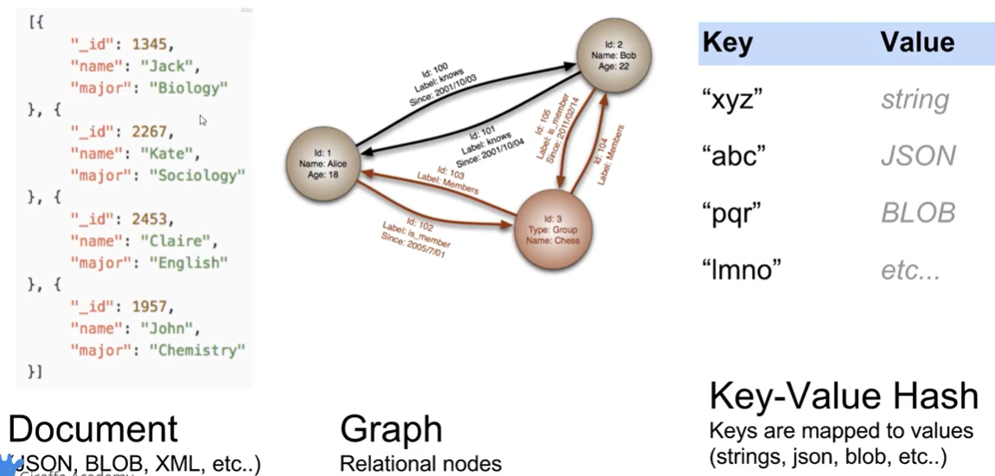
Non – Relational Databases

Slide 9
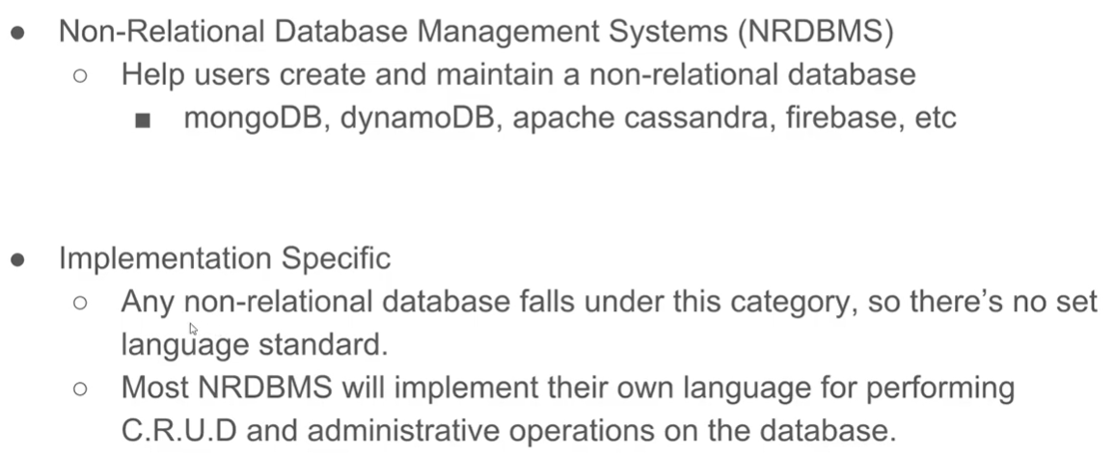
Non- Relational Databases (No SQL)

Slide 10
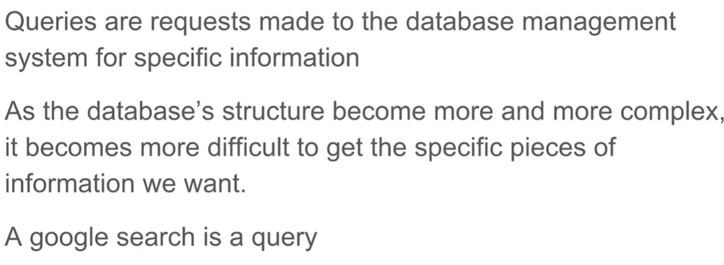
Database Queries

Slide 11
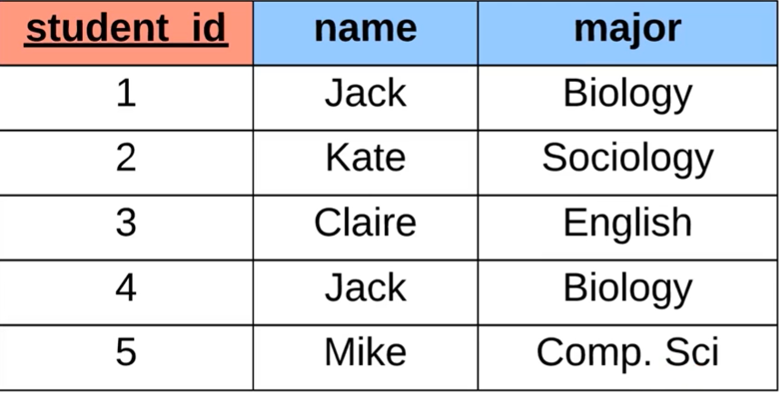
Storing data in Relational databases
A column is a single attribute
A row is a single record
A primary key is an attribute which uniquely identifies a row

Slide 12
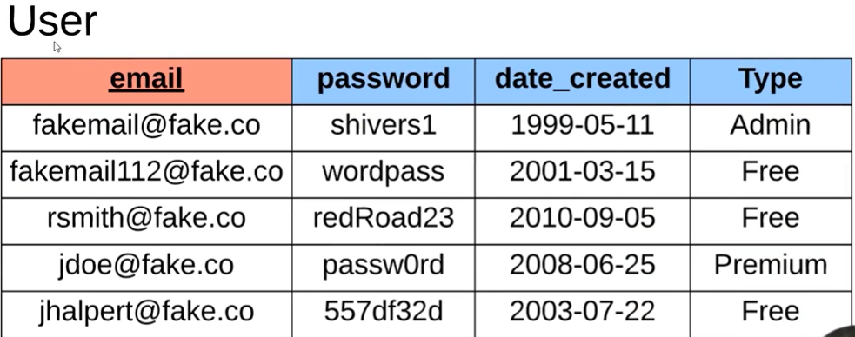
Storing data in Relational databases

Slide 13
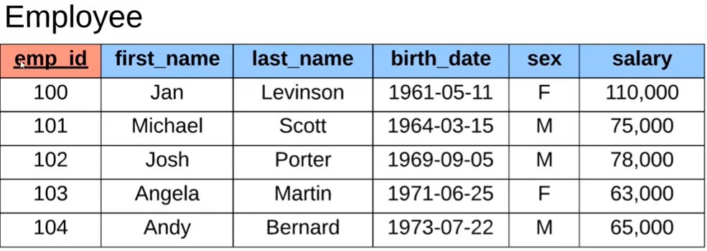
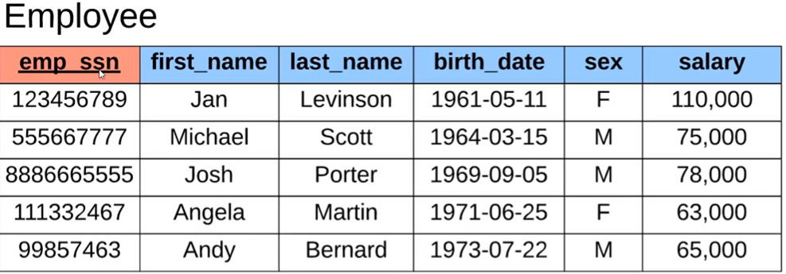

Slide 14
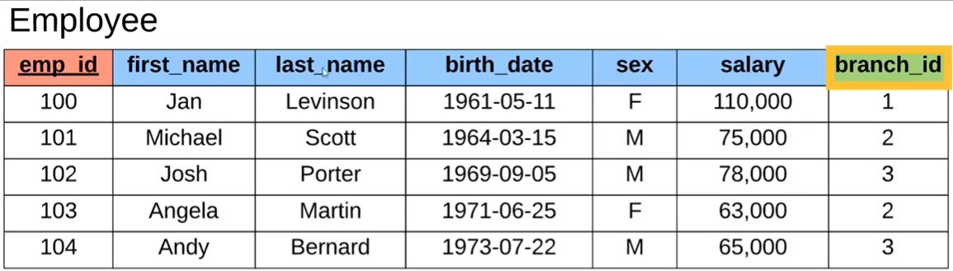
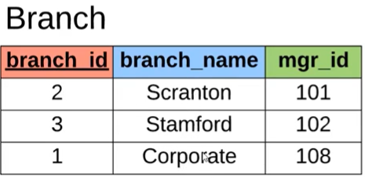
Foreign Keys
A foreign key allows to define relationships between tables

Slide 15
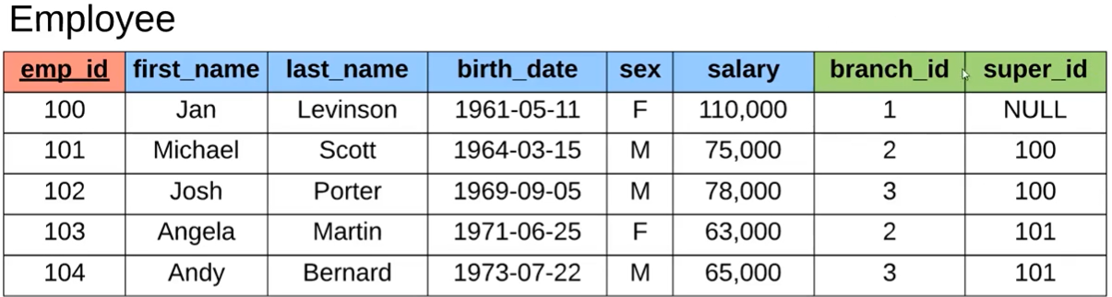
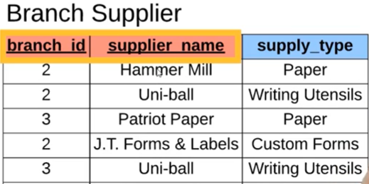

Slide 16
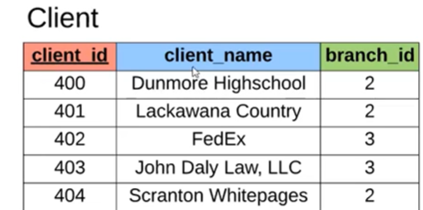
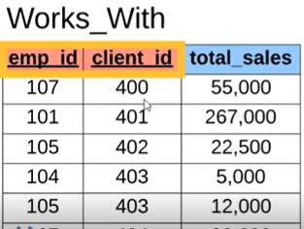

Slide 17
Structured Query Language (SQL)
SQL is a language used for interacting with Relational Database Management System (RDBMS)
You can use SQL to get the RDBMS to:
Create, retrieve update and delete data.
Create and manage databases.
Design and manage database tables.
Perform administration tasks (security, user management, etc)

Slide 18
Structured Query Language (SQL)
SQL is a hybrid language, it has 4 types of languages in one:
Data Query Language (DQL)
Used to query the database for information
Get information that is already stored
Data Definition Language (DDL)
Used for defining database schemas
Data Control Language (DCL)
Used for controlling access to the database
Data Manipulation Language (DML)
Used for inserting, updating and deleting data from the database

